Slide 1
Chapter 10. Indexing
Why indexing
Linear Indexing
Tree indexing
  2-3 Trees
  B Trees
再次复习：6,15,23-47,51,54,55,58,70,71

Slide 2
Why Indexing
Limitations of Hashing ???
  Support multiple search keys?
  Support range queries ?

Slide 3
Why Indexing
Goals:
  Organize a large collection of records stored on disk.
  Support multiple search keys.
  Support efficient insert, delete, and range queries

Slide 4
Index File
Support : insert, delete, and range queries
Index file on different keys
index
index
index
index
Records on disk

Slide 5
Indexing
Why indexing
Linear Indexing
Tree indexing
  2-3 Trees
  B Trees

Slide 6
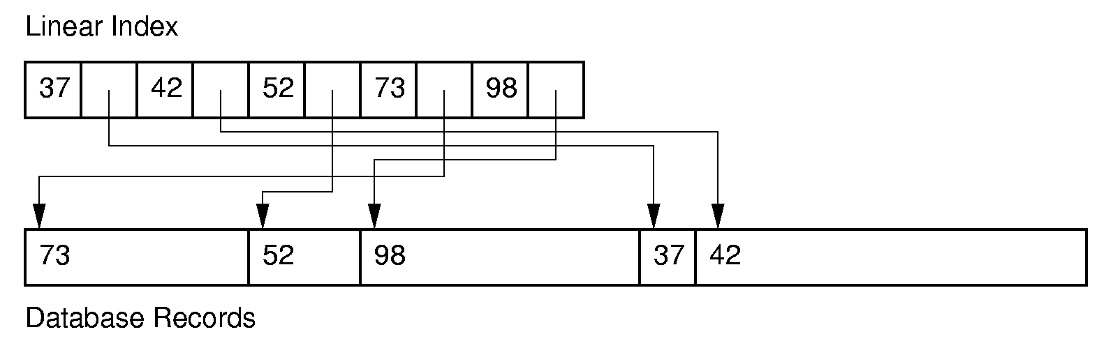
Linear Indexing (1)
Linear index: Index file organized as a simple sequence of (key, record pointer) pairs with key values are in sorted order.
Linear indexing is good for searching variable-length records.
Notes:
A linear index is good for indexing an entry sequenced file.

Slide 7
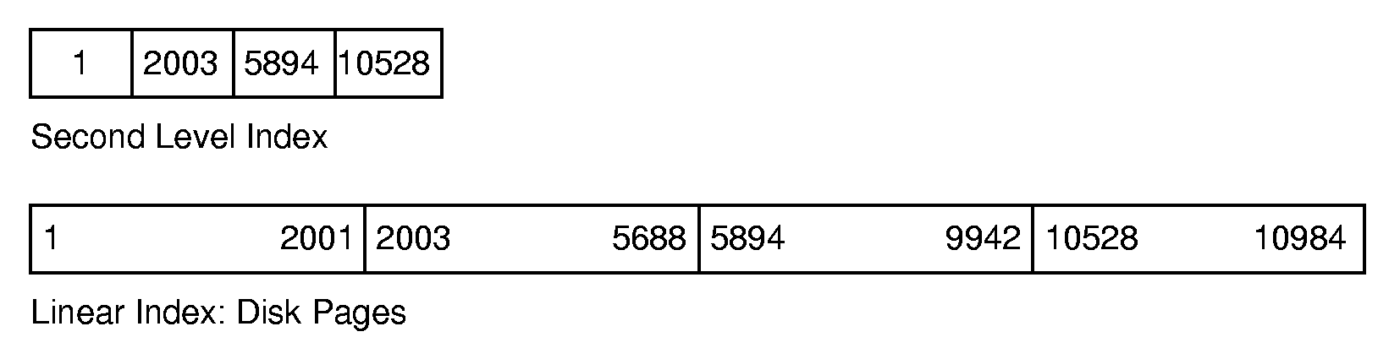
Linear Indexing (2)
If the index is too large to fit in main memory, a second-level index might be used.
How to search?
Notes:
Second level index stores the first key for each disk page.

Slide 8
What to improve?
Insertion and deletion operation can cause massive update of the index file ( Θ(n))

Slide 9
Indexing
Why indexing
Linear Indexing
Tree indexing
  2-3 Trees
  B Trees

Slide 10
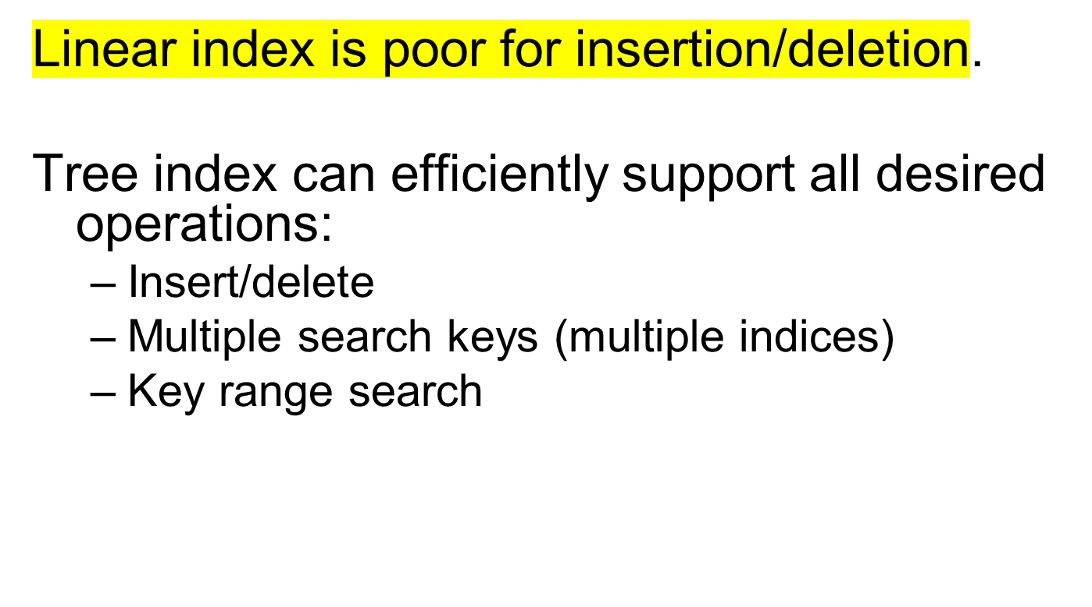
Tree Indexing (1)

Slide 11
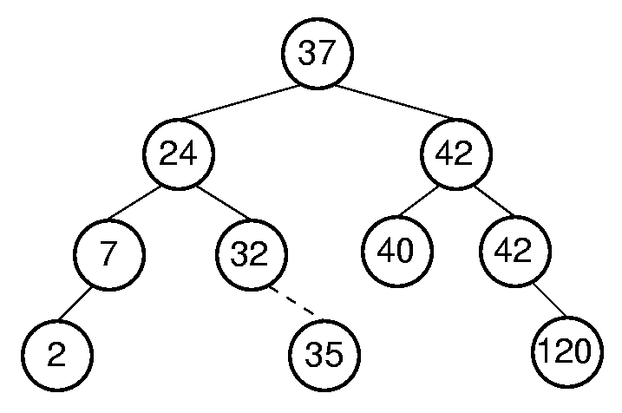
Tree Indexing (2)
Can BST be used as Tree indexing??
Search/insert/delete: Θ(log n) in average case.
.
Notes:
Second figure illustrates how difficult it can be to keep a tree balanced. In this case, rebalancing the BST to maintain the complete tree shape requires that all nodes be moved. This is too expensive to be practical.

Slide 12
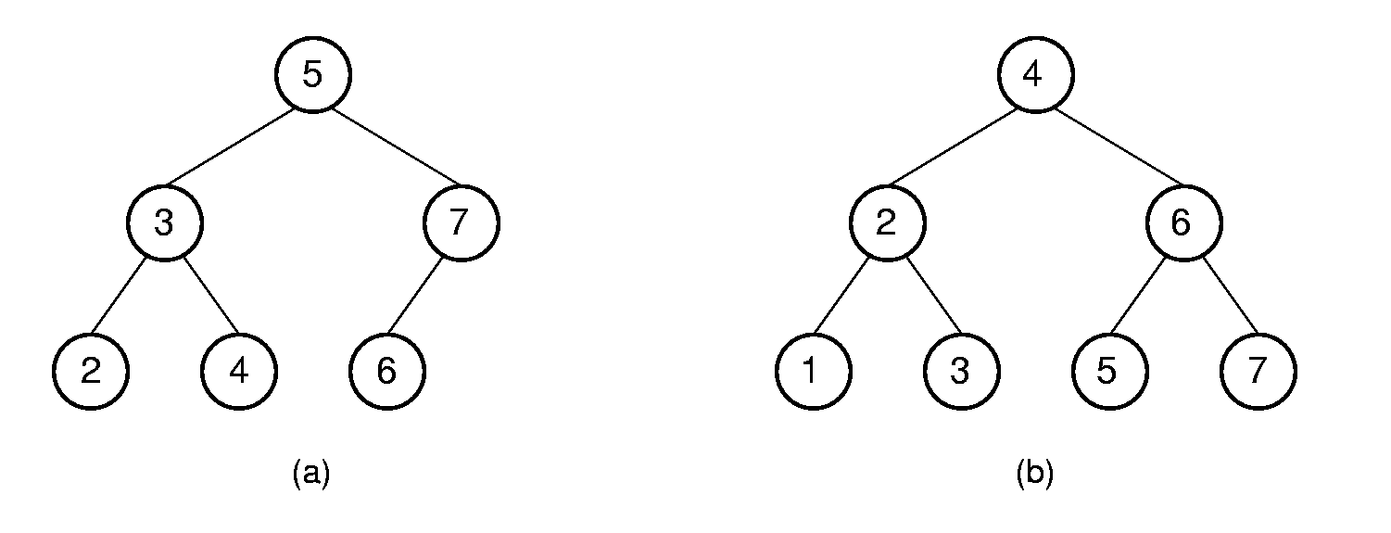
Tree Indexing (3)
Difficulties when storing BST tree index on disk:
  The cost of searching a keyword of a node is decided by the depth of the node.
  It’s better to keep the tree balanced. It’s best to keep the tree as a complete binary tree.
  It is expensive to keep BST balanced or complete.
Insert 1
To keep the BST as a complete binary tree after inserting 1,
many records required to refresh.
Notes:
Second figure illustrates how difficult it can be to keep a tree balanced. In this case, rebalancing the BST to maintain the complete tree shape requires that all nodes be moved. This is too expensive to be practical.

Slide 13
Indexing
Why indexing
Linear Indexing
Tree indexing
  2-3 Trees
  B Trees

Slide 14
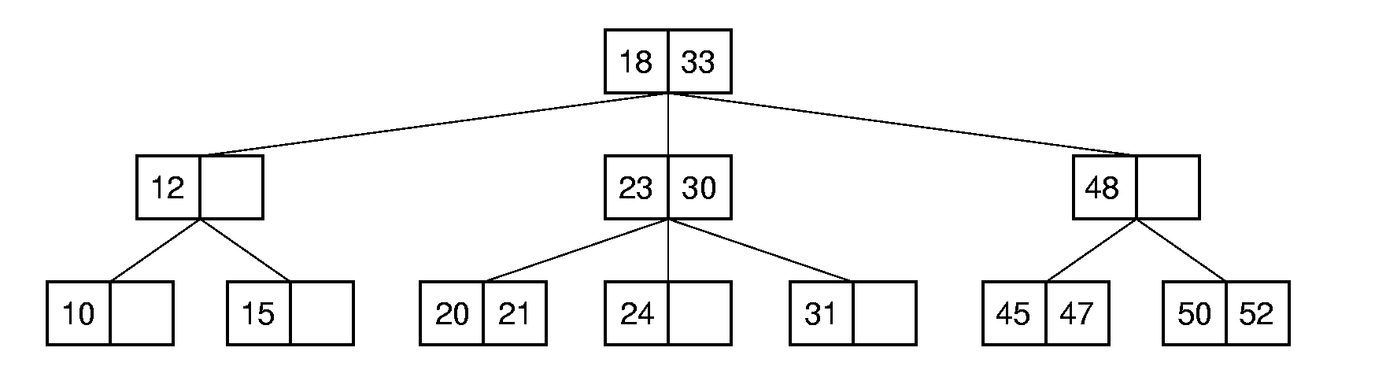
2-3 Tree (1)
The 2-3 Tree has a search tree property analogous to the BST.
The advantage of the 2-3 Tree over the BST is that it can be updated at low cost.

Slide 15
2-3 Tree (2)
A 2-3 Tree has the following properties:
  A node contains one or two keys
  Every internal node has either two children (if it contains one key) or three children (if it contains two keys).
  All leaves are at the same level in the tree, so the tree is always height balanced.

Slide 16
2-3 Tree Searching
Search 21
Θ(log n)

Slide 17
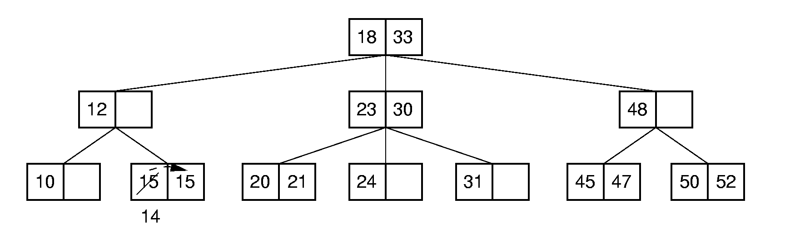
2-3 Tree Insertion (1)
Case 1
Insert 14

Slide 18
2-3 Tree Insertion (2)
Case 2
Split the node.
23
23
19
21
24
20
21
24
split
20
20
23
Insert 19
19
21
24

Slide 19
2-3 Tree Insertion (3)
Case 3
18
18
split
23
30
23
30
20
21
24
31
19
21
24
31
20
18
Insert 19
20
23
30
19
21
24
31

Slide 20
2-3 Tree Insertion (3)
18
20
23
30
19
21
24
31
split
18
23
20
30
19
21
24
31

Slide 21
2-3 Tree Insertion (3)
18
23
20
30
19
21
24
31
18
23
20
30
19
21
24
31

Slide 22
Implementation of 2-3 Tree
template <class Elem>
class TTNode { // 2-3 tree node structure
public:
Elem lkey;
Elem rkey;
TTNode* left;
TTNode* center;
TTNode* right;
TTNode()
{ center = left = right = NULL; lkey = rkey = EMPTY; }
~TTNode() { }
bool isLeaf() { return left = = NULL; }
};
lkey
rkey
left
center
right

Slide 23
Implementation of 2-3 Tree searching
template <class Key, class Elem >
bool TTTree<Key, Elem>::
findhelp(TTNode<Elem>* subroot, const Key& K, Elem& e) const {
if (subroot = = NULL) return false;
if (K == getkey(subroot->lkey))
{ e = subroot->lkey; return true; }
if (subroot->rkey != EMPTY &&
K==getkey(subroot->rkey))
{ e = subroot->rkey; return true; }
if (K < getkey(subroot->lkey))
return findhelp(subroot->left, K, e);
else if (subroot->rkey = = EMPTY)
return findhelp(subroot->center, K, e);
else if (K < getkey(subroot->rkey))
return findhelp(subroot->center, K, e);
else return findhelp(subroot->right, K, e);
}
lkey
rkey
left
center
right

Slide 24
Implementation of 2-3 Tree insertion
template <class Key, class Elem>
bool TTTree<Key, Elem>::
inserthelp(TTNode<Elem>*& subroot, const Elem& e,
Elem& retval, TTNode<Elem>*& retptr) {
23
23
subroot
24
19
21
20
21
24
retptr
retval
20
20
23
Insert 19
e
19
21
24

Slide 25
template <class Key, class Elem>
bool TTTree<Key, Elem>::
inserthelp(TTNode<Elem>*& subroot, const Elem& e,
Elem& retval, TTNode<Elem>*& retptr)
{
Elem myretv;
TTNode<Elem>* myretp = NULL;
if (subroot = = NULL) // Empty tree: make new node
{ subroot = new TTNode<Elem>( ); subroot->lkey = e; }
subroot
e
NULL
NULL
NULL

Slide 26
template <class Key, class Elem>
bool TTTree<Key, Elem>::
inserthelp(TTNode<Elem>*& subroot, const Elem& e,
Elem& retval, TTNode<Elem>*& retptr) {
Elem myretv; TTNode<Elem>* myretp = NULL;
if (subroot = = NULL) // Empty tree: make new node
{ subroot = new TTNode<Elem>( ); subroot->lkey = e; }
else if (subroot->isLeaf( )) // At leaf node: insert here
if (subroot->rkey = = EMPTY) { // Easy case: not full
if (subroot->lkey < e)
subroot->rkey = e;
else {subroot->rkey = subroot->lkey;
subroot->lkey = e; }
}
else splitnode(subroot, e, NULL, retval, retptr);
lkey
e
NULL
NULL
NULL

Slide 27
template <class Key, class Elem>
bool TTTree<Key, Elem>::
inserthelp(TTNode<Elem>*& subroot, const Elem& e,
Elem& retval, TTNode<Elem>*& retptr) {
Elem myretv; TTNode<Elem>* myretp = NULL;
if (subroot = = NULL) // Empty tree: make new node
{ subroot = new TTNode<Elem>( ); subroot->lkey = e; }
else if (subroot->isLeaf( )) // At leaf node: insert here
if (subroot->rkey = = EMPTY) { // Easy case: not full
if (subroot->lkey < e)
subroot->rkey = e;
else {subroot->rkey = subroot->lkey;
subroot->lkey = e; }
}
else splitnode(subroot, e, NULL, retval, retptr);
lkey
NULL
NULL
NULL

Slide 28
template <class Key, class Elem>
bool TTTree<Key, Elem>::
inserthelp(TTNode<Elem>*& subroot, const Elem& e,
Elem& retval, TTNode<Elem>*& retptr) {
Elem myretv; TTNode<Elem>* myretp = NULL;
if (subroot = = NULL) // Empty tree: make new node
{ subroot = new TTNode<Elem>( ); subroot->lkey = e; }
else if (subroot->isLeaf( )) // At leaf node: insert here
if (subroot->rkey = = EMPTY) { // Easy case: not full
if (subroot->lkey < e)
subroot->rkey = e;
else {subroot->rkey = subroot->lkey;
subroot->lkey = e; }
}
else splitnode(subroot, e, NULL, retval, retptr);
e
lkey
NULL
NULL
NULL

Slide 29
template <class Key, class Elem>
bool TTTree<Key, Elem>::
inserthelp(TTNode<Elem>*& subroot, const Elem& e,
Elem& retval, TTNode<Elem>*& retptr) {
Elem myretv; TTNode<Elem>* myretp = NULL;
if (subroot = = NULL) // Empty tree: make new node
{ subroot = new TTNode<Elem>( ); subroot->lkey = e; }
else if (subroot->isLeaf( )) // At leaf node: insert here
if (subroot->rkey = = EMPTY) { // Easy case: not full
if (subroot->lkey < e)
subroot->rkey = e;
else {subroot->rkey = subroot->lkey;
subroot->lkey = e; }
}
else splitnode(subroot, e, NULL, retval, retptr);
lkey
rkey
NULL
NULL
NULL

Slide 30
template <class Key, class Elem>
bool TTTree<Key, Elem>::
inserthelp(TTNode<Elem>*& subroot, const Elem& e,
Elem& retval, TTNode<Elem>*& retptr) {
Elem myretv; TTNode<Elem>* myretp = NULL;
… … …
else if (e < subroot->lkey) // Insert in child
inserthelp(subroot->left, e, myretv, myretp);
subroot
// insert e to an internode
lkey
rkey
left
center
right
Insert e

Slide 31
template <class Key, class Elem>
bool TTTree<Key, Elem>::
inserthelp(TTNode<Elem>*& subroot, const Elem& e,
Elem& retval, TTNode<Elem>*& retptr) {
Elem myretv; TTNode<Elem>* myretp = NULL;
… … …
else if (e < subroot->lkey) // Insert in lchild
inserthelp(subroot->left, e, myretv, myretp);
subroot
// insert e to an internode
lkey
rkey
left
center
right
myretv
myretp

Slide 32
template <class Key, class Elem>
bool TTTree<Key, Elem>::
inserthelp(TTNode<Elem>*& subroot, const Elem& e,
Elem& retval, TTNode<Elem>*& retptr) {
Elem myretv; TTNode<Elem>* myretp = NULL;
… … …
else if ((subroot->rkey = = EMPTY) ||
(e < subroot->rkey ))
inserthelp(subroot->center, e, myretv, myretp);
else inserthelp(subroot->right, e, myretv, myretp);
subroot
// insert e to an internode
lkey
left
center
Insert e

Slide 33
template <class Key, class Elem>
bool TTTree<Key, Elem>::
inserthelp(TTNode<Elem>*& subroot, const Elem& e,
Elem& retval, TTNode<Elem>*& retptr) {
Elem myretv; TTNode<Elem>* myretp = NULL;
… … …
else if ((subroot->rkey = = EMPTY) ||
(e < subroot->rkey ))
inserthelp(subroot->center, e, myretv, myretp);
else inserthelp(subroot->right, e, myretv, myretp);
subroot
// insert e to an internode
lkey
rkey
left
center
Insert e

Slide 34
template <class Key, class Elem>
bool TTTree<Key, Elem>::
inserthelp(TTNode<Elem>*& subroot, const Elem& e,
Elem& retval, TTNode<Elem>*& retptr) {
Elem myretv; TTNode<Elem>* myretp = NULL;
… … …
else if ((subroot->rkey = = EMPTY) ||
(e < subroot->rkey ))
inserthelp(subroot->center, e, myretv, myretp);
else inserthelp(subroot->right, e, myretv, myretp);
subroot
// insert e to an internode
lkey
rkey
left
center
myretv
myretp

Slide 35
template <class Key, class Elem>
bool TTTree<Key, Elem>::
inserthelp(TTNode<Elem>*& subroot, const Elem& e,
Elem& retval, TTNode<Elem>*& retptr) {
Elem myretv; TTNode<Elem>* myretp = NULL;
… … …
else if ((subroot->rkey = = EMPTY) ||
(subroot->rkey > getkey(e)))
inserthelp(subroot->center, e, myretv, myretp);
else inserthelp(subroot->right, e, myretv, myretp);
subroot
// insert e to an internode
lkey
rkey
right
left
center
Insert e

Slide 36
template <class Key, class Elem>
bool TTTree<Key, Elem>::
inserthelp(TTNode<Elem>*& subroot, const Elem& e,
Elem& retval, TTNode<Elem>*& retptr) {
Elem myretv; TTNode<Elem>* myretp = NULL;
… … …
else if ((subroot->rkey = = EMPTY) ||
(subroot->rkey > getkey(e)))
inserthelp(subroot->center, e, myretv, myretp);
else inserthelp(subroot->right, e, myretv, myretp);
subroot
// insert e to an internode
lkey
rkey
right
left
center
myretv
myretp

Slide 37
//If myretp is not NULL，insert myretv into subroot
if (myretp != NULL)
if (subroot->rkey != EMPTY) // Full: split node
splitnode(subroot, myretv, myretp, retval, retptr);
subroot
lkey
rkey
right
left
center
myretv
myretp

Slide 38
if (myretp != NULL) // Child split: receive promoted value
… … … …
else { // Not full: add to this node
if (myretv < subroot->lkey)) {
subroot->rkey = subroot->lkey;
subroot->lkey = myretv;
subroot->right = subroot->center;
subroot->center = myretp;
}
subroot
lkey
left
center
myretv
myretp

Slide 39
if (myretp != NULL) // Child split: receive promoted value
… … … …
else { // Not full: add to this node
if (myretv < subroot->lkey)) {
subroot->rkey = subroot->lkey;
subroot->lkey = myretv;
subroot->right = subroot->center;
subroot->center = myretp;
}
subroot
myretv
lkey
left
center
right
myretv
myretp

Slide 40
if (myretp != NULL) // Child split: receive promoted value
… … … …
else { // Not full: add to this node
if (myretv < subroot->lkey)) {
subroot->rkey = subroot->lkey;
subroot->lkey = myretv;
subroot->right = subroot->center;
subroot->center = myretp;
}
else
{ subroot->rkey = myretv; subroot->right = myretp; }
}
return true;
}
subroot
lkey
left
center
myretv
myretp

Slide 41
if (myretp != NULL) // Child split: receive promoted value
… … … …
else { // Not full: add to this node
if (myretv < subroot->lkey)) {
subroot->rkey = subroot->lkey;
subroot->lkey = myretv;
subroot->right = subroot->center;
subroot->center = myretp;
}
else
{ subroot->rkey = myretv; subroot->right = myretp; }
}
return true;
}
subroot
lkey
myretv
left
center
right
myretv
myretp

Slide 42
Implementation of 2-3 tree insertion-- splitnode
template <class Key, class Elem>
bool TTTree<Key, Elem>::
splitnode(TTNode<Elem>* subroot, const Elem& inval,
TTNode<Elem>*inptr, Elem& retval, TTNode<Elem>*& retptr){
23
split
subroot
23
subroot
19
20
24
19
21
24
Insert 21
retval
20
retptr
inval
分裂的节点是叶子节点的情况
Splitnode( subroot, 21, NULL, retval, retptr)

Slide 43
template <class Key, class Elem>
bool TTTree<Key, Elem>::
splitnode(TTNode<Elem>* subroot, const Elem& inval,
TTNode<Elem>*inptr, Elem& retval, TTNode<Elem>*& retptr){
18
18
subroot
23
30
subroot
23
30
19
20
24
31
19
21
24
31
Insert 21
20
分裂的节点是中间节点的情况

Slide 44
template <class Key, class Elem>
bool TTTree<Key, Elem>::
splitnode(TTNode<Elem>* subroot, const Elem& inval,
TTNode<Elem>*inptr, Elem& retval, TTNode<Elem>*& retptr){
18
分裂的节点是中间节点的情况
subroot
23
30
retval
19
21
24
31
18
retptr
23
20
split
inptr
20
30
inval
19
21
24
31

Slide 45
template <class Key, class Elem>
splitnode(TTNode<Elem>* subroot, const Elem& inval,
TTNode<Elem>*inptr, Elem& retval, TTNode<Elem>*& retptr){
retptr = new TTNode<Elem>( ); // Node created by split
if (inval < subroot->lkey)) { // Add at left
retval = subroot->lkey; subroot->lkey = inval;
retptr->lkey = subroot->rkey; retptr->left = subroot->center;
retptr->center = subroot->right; subroot->center = inptr; }
subroot
23
30
retval
19
21
24
31
subroot
retptr
23
20
split
inptr
20
30
inval
19
21
24
31

Slide 46
template <class Key, class Elem>
splitnode(TTNode<Elem>* subroot, const Elem& inval,
TTNode<Elem>*inptr, Elem& retval, TTNode<Elem>*& retptr){
… … … …
else if (inval < subroot->rkey)) { // Center
retval = inval; retptr->lkey = subroot->rkey;
retptr->left = inptr; retptr->center = subroot->right; }
subroot
23
30
retval
19
24
28
31
subroot
retptr
25
25
inptr
23
30
split
inval
19
24
28
31

Slide 47
template <class Key, class Elem>
splitnode(TTNode<Elem>* subroot, const Elem& inval,
TTNode<Elem>*inptr, Elem& retval, TTNode<Elem>*& retptr){
… … … …
else { // Add at right
retval = subroot->rkey; retptr->lkey = inval;
retptr->left = subroot->right; retptr->center = inptr; }
}
subroot->rkey = EMPTY;
subroot
23
30
retval
19
24
31
35
subroot
retptr
30
33
inptr
inval
23
33
split
19
24
31
35

Slide 48
How to improve 2-3 tree
How to implement the 2-3 tree on the disk.
Reduce the height of the tree to reduce the disk I/O operations when searching and updating the tree.
硬盘读写单元

Slide 49
Indexing
Why indexing
Linear Indexing
Tree indexing
  2-3 Trees
  B Trees

Slide 50
B-Trees (1)
The B-Tree is an extension of the 2-3 Tree.
The B-Tree is now the standard file organization for applications requiring insertion, deletion, and key range searches.

Slide 51
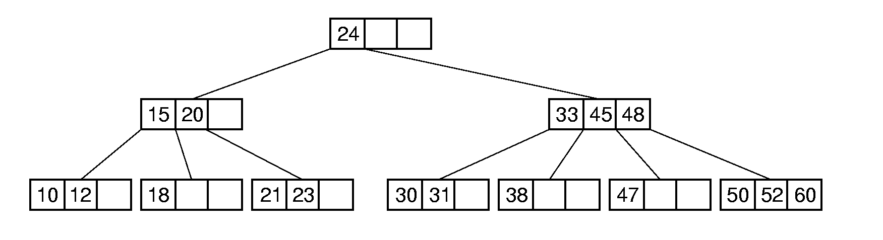
B-Tree Definition (1)
A B-Tree of order m (m阶B树) has these properties:
  The root is either a leaf or has at least two children.
  Each node, except for the root and the leaves, has between ⎡m/2⎤ and m children.
  All leaves are at the same level in the tree, so the tree is always height balanced.
B-tree of order 4

Slide 52
B-Tree Definition (2)
A B-Tree node is usually selected to match the size of a disk block to reduce the disk I/O operations
  A B-Tree node could have hundreds of children.

Slide 53
B-Tree Search
Search in a B-Tree is a generalization of search in a 2-3 Tree.
  Search from the root of the tree.
  Do binary search on keys in the current node. If the key is found, then return the record. If the current node is a leaf node and the key is not found, then report an unsuccessful search.
  Otherwise, follow the proper branch and repeat the process.
B-tree of order 4

Slide 54
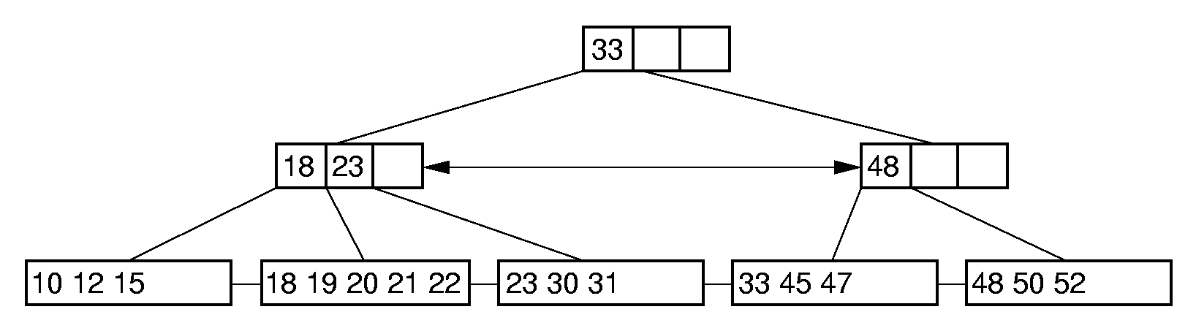
B⁺-Trees （1）
The most commonly implemented form of the B-Tree is the B⁺-Tree.
Internal nodes of the B⁺-Tree do not store records or pointers to records -- only key values to guide the search.
Leaf nodes store records or pointers to records.
All of the nodes in the same level are linked together.
Support Range query well

Slide 55
B⁺-Trees （2）
The root is either a leaf or has at least two children.
Each node, except for the root and the leaves, has
⎡m/2⎤ ~ m children, and has ⎡m/2⎤ - 1 ~ m – 1 keys
If each leaf can store n records at most (n may be not
equal to m -1), it must store ⎡n/2 ⎤ records at least
Example: B⁺ tree of order 4. Each internal nodes have 2~4 children.
Assume that each leaf can store 5 records at most. At least 3 records
should be contained in a leaf.

Slide 56
B⁺-Tree Insertion (1)
18 33
Case 1:
10 12 15
18 20 21
33 47 50
Insert 45
18 33
10 12 15
18 20 21
33 45 47 50
B+ tree of order 4. Each leaf contains 3~5 records.

Slide 57
B⁺-Tree Insertion (2)
18 33
10 12 15
18 20 21 24 30
33 45 47
Case 2:
Insert 26
18 33
10 12 15
18 20 21
24 26 30
33 45 47
split
B+ tree of order 4. Each leaf contains 3~5 records.

Slide 58
B⁺-Tree Insertion (2)
18 33
10 12 15
18 20 21
24 26 30
33 45 47
18 24 33
10 12 15
18 20 21
24 26 30
33 45 47
分裂结点时，将新分出来的右子树中的最小的关键字提升，
插入到父结点的合适位置；如果没有父结点，则创建一个新的父结点，插入该上升的关键字
B+ tree of order 4. Each leaf contains 3~5 records.

Slide 59
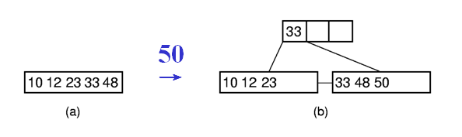
B⁺-Tree Insertion (3)
Case 3:
分裂结点时，将新分出来的右子树中的最小的关键字提升，
插入到父结点的合适位置；如果没有父结点，则创建一个新的父结点，插入该上升的关键字
B+ tree of order 4. Each leaf contains 3~5 records.

Slide 60
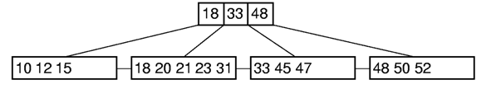
B⁺-Tree Insertion (4)
Case 4:
Insert 30
18 33 48
Split
10 12 15
18 20 21
23 30 31
33 45 47
48 50 52
18 23 33 48
10 12 15
18 20 21
23 30 31
33 45 47
48 50 52
B+ tree of order 4. Each leaf contains 3~5 records.

Slide 61
B⁺-Tree Insertion (4)
18 23 33 48
Split again
10 12 15
18 20 21
23 30 31
33 45 47
48 50 52
18 23
48
10 12 15
18 20 21
23 30 31
33 45 47
48 50 52
33
Θ(log n)
18 23
48
10 12 15
18 20 21
23 30 31
33 45 47
48 50 52
B+ tree of order 4. Each leaf contains 3~5 records.

Slide 62
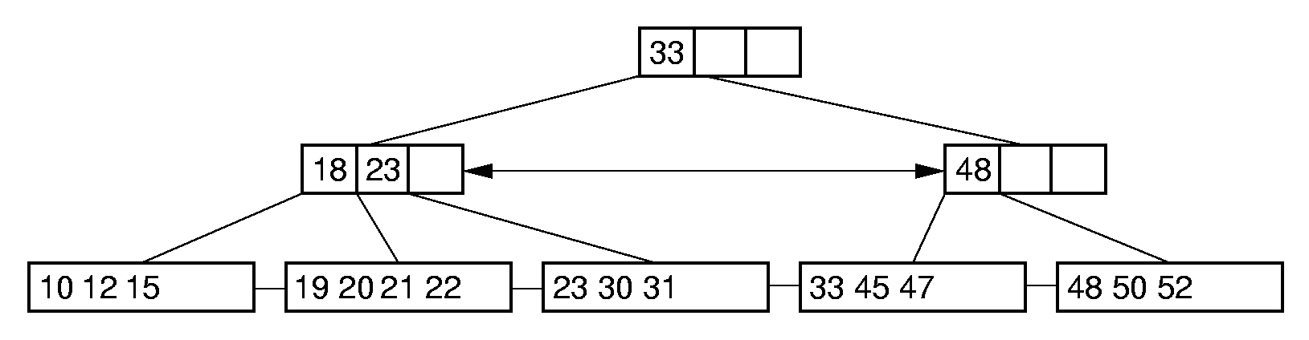
B⁺-Tree Deletion (1)
Case 1:
↓delete 18
B+ tree of order 4. Each leaf contains 3~5 records.
Notes:
Delete 18

Slide 63
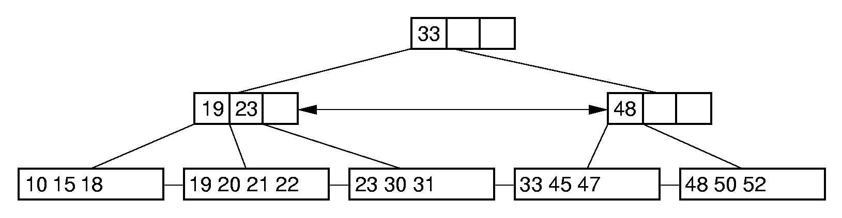
B⁺-Tree Deletion (2)
Case 2:
↓delete 12
兄弟富则兄弟帮
B+ tree of order 4. Each leaf contains 3~5 records.
Notes:
Delete 12. Borrow 18 from the second child.

Slide 64
B⁺-Tree Deletion (3)
Case 3:
兄弟穷则和兄弟合并
↓delete 33
33
18 23
10 12 15
18 19 20 21 22
23 30 31
45 47 48 50 52
B+ tree of order 4. Each leaf contains 3~5 records.
Notes:
Delete 33.

Slide 65
B⁺-Tree Deletion (3)
33
兄弟富则兄弟帮
18 23
10 12 15
18 19 20 21 22
23 30 31
45 47 48 50 52
23
Θ(log n)
18
33
10 12 15
18 19 20 21 22
23 30 31
45 47 48 50 52
B+ tree of order 4. Each leaf contains 3~5 records.
Notes:
Delete 33.

Slide 66
B⁺-Tree Deletion (4)
23
Case 4:
33
18
10 12 15
18 19 20 21 22
23 30 31
45 47 48
兄弟穷则和兄弟合并
↓delete 47
23
18
10 12 15
18 19 20 21 22
23 30 31 45 48
B+ tree of order 4. Each leaf contains 3~5 records.
Notes:
Delete 33.

Slide 67
B⁺-Tree Deletion (4)
兄弟穷则和兄弟合并
23
18
10 12 15
18 19 20 21 22
23 30 31 45 48
↓
18 23
10 12 15
18 19 20 21 22
23 30 31 45 48
Notes:
Delete 33.

Slide 68
B⁺-Tree Deletion (4)
18 23
10 12 15
18 19 20 21 22
23 30 31 45 48
↓
18 23
10 12 15
18 19 20 21 22
23 30 31 45 48
持续的合并导致树的高度的塌缩

Slide 69
Cost Analysis (1)
Asymptotic cost of search, insertion, and deletion of nodes from B-Trees is Θ(log_{r} n).
  Base of the log is the (average) branching factor of the tree.
  If the base is big enough, the B-tree is very efficient to index a large collection of records.

Slide 70
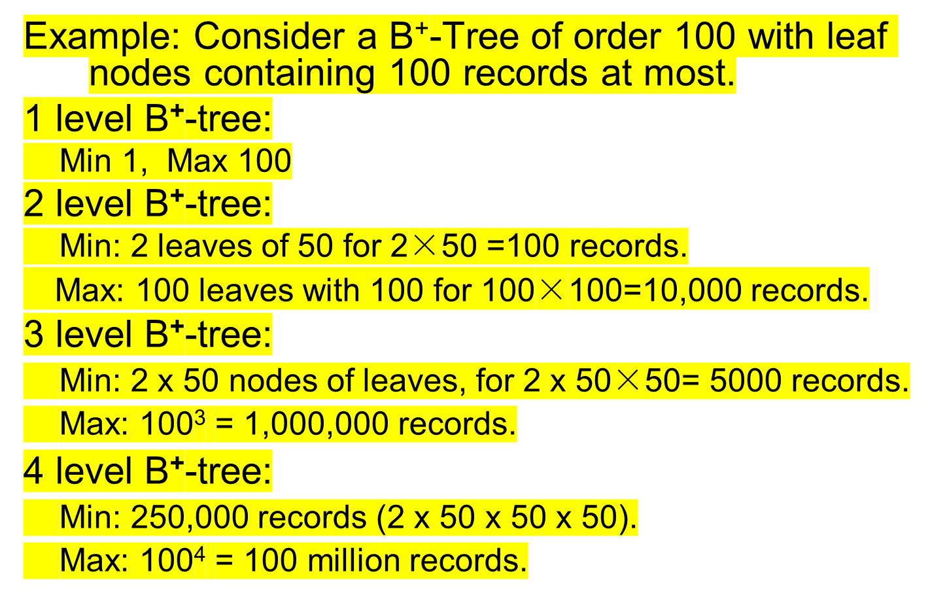
Cost Analysis (2)

Slide 71
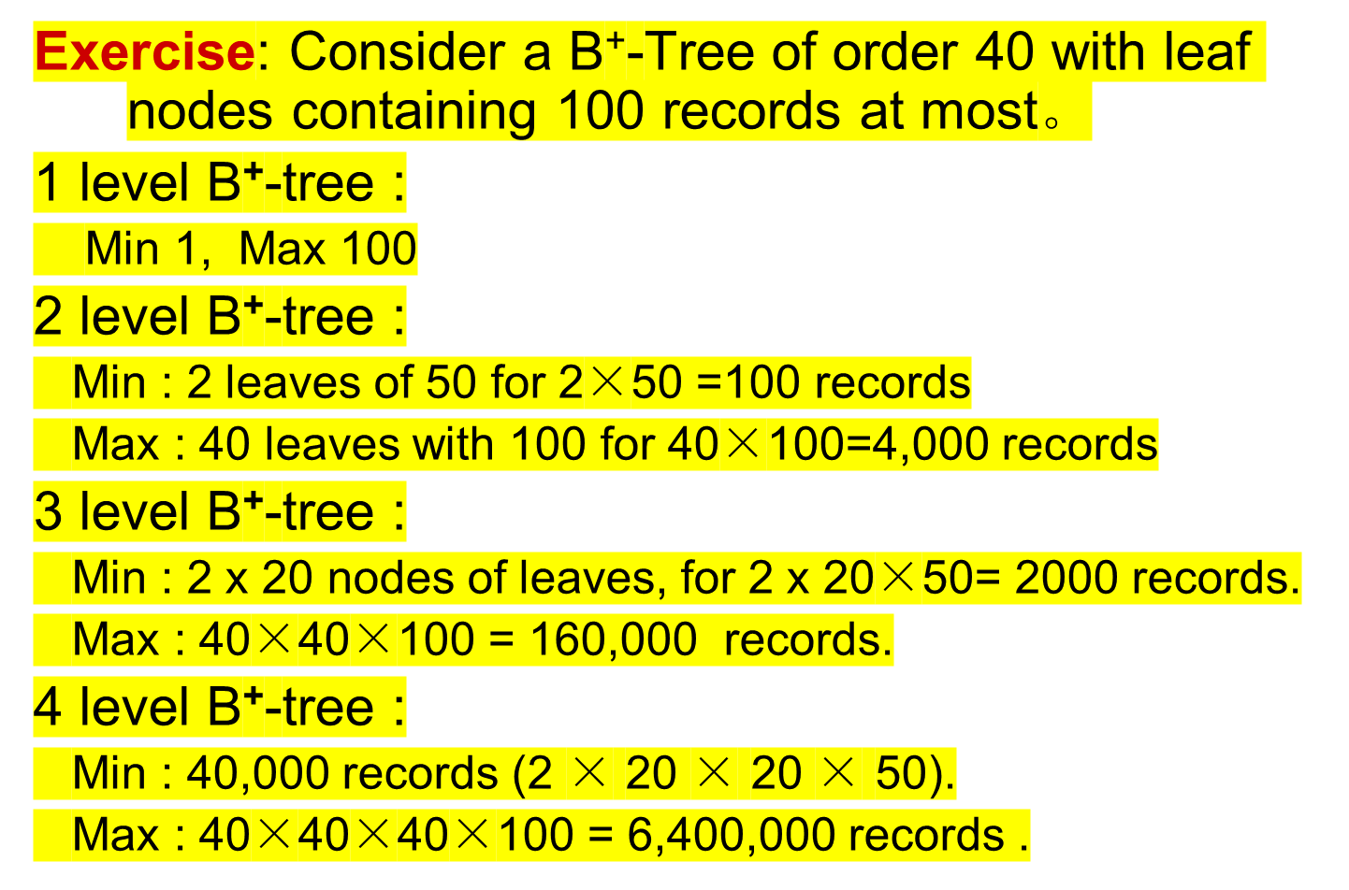
Cost Analysis (3)

Slide 72
Summary
B-Trees are always balanced.
B-Trees keep similar-valued records together on a disk page, which takes advantage of locality of reference .
The height of B-Trees is relatively low, which can reduce the disk I/O operations.

